Slide 1
Project #1: EDA and Git Collaboration
APIsmanTrophy
Dan Murphy (Lead)
Tim Bryan
Joe Mazanec
Jim Strale
Andrew Goodwin

Slide 2
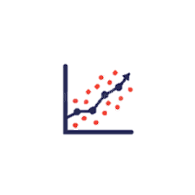




Data Science Workflow
Report Results
Define objective
Explore/clean data
Import data

Slide 3
Define Objective
Problem statement
Newly available sports gambling applications have taken too much money from the average gambler. We have set out to identify data elements that could affect the score of college football games and be used to help predict the winner.
Questions
Does attendance/fill rate affect home team winning?
Does attendance/fill rate affect win margin?
Does weather affect total score?
Does gametime affect total score?
Do televised games affect total score?

Slide 4
Import Data
Locate data source
Kaggle.com
https://www.kaggle.com/datasets/jeffgallini/college-football-attendance-2000-to-2018
Sample
6,672 Division I CFB (College Football) games between 2000 – 2018
Structure
CSV file structure (cfb_attendance.csv)

Slide 5
Clean/Explore Data
Checked for missing values in each column
All values present
Reviewed column data types
Converted some columns to proper data type
Parsed out “Results” column
Removed spring games (winner labeled as a color)
Removed overtime games
Removed vacated games
Removed special characters
Split into separate columns of “Home Score”, “Away Score”, and “W/L”
Parsed out “Site” column
Formatted to be “Venue name, City, State (abrv)”
Made separate column containing only “City, State (abrv)”

Slide 6
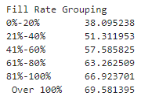
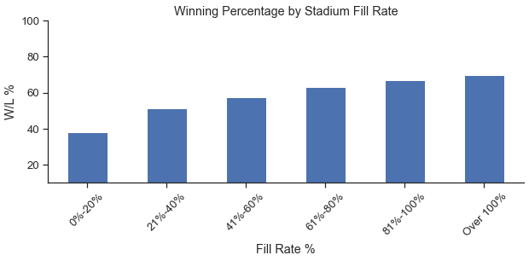
Report Results
Does attendance/fill rate affect home team winning?
As the fill rate of the home team stadium get larger the home team wins more often. The fill rate and number of times the home team win demonstrates a positive correlation.
A conclusion using this information could be to place a bet on the home team when the attendance is closer to 100% of the stadium’s capacity.
Notes:
Fill rate can be defined as the rate of attendance over individual stadium capacity or simply how packed is the home team stadium. Fill rates in our data set range from 6% to 140%. It was observed that the fill rate and number of times the home team wins demonstrates a positive correlation. As the fill rate of the home team stadium gets larger the home team wins more often. Starting with a fill rate of 0-20% the home team only claimed victory ~38% of the time while a fill rate of 81-100% & even a fill rate of > 100% resulted in a home team winning percentage of ~68% & ~69.5% respectively. A conclusion using this information could be to place a bet on the home team to win when the attendance is closer to 100% of the stadium’s fill rate capacity.

Slide 7
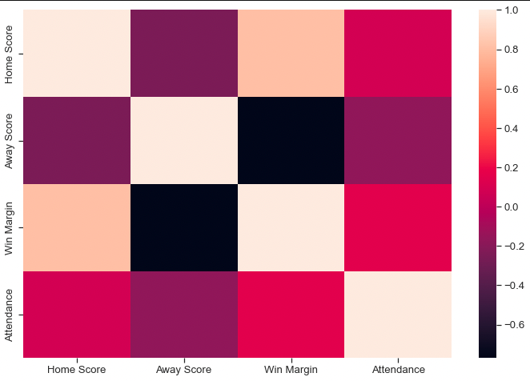
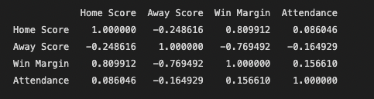
Report Results
Does attendance affect win margin?
Win margin and attendance do not have a significant correlation to one another leaving the correlation to have a coefficient of .15 making this a null hypothesis.

Slide 8
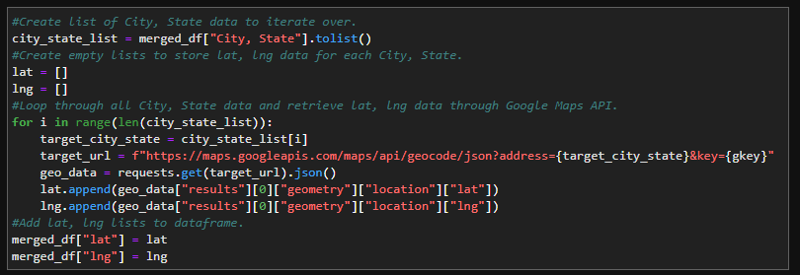
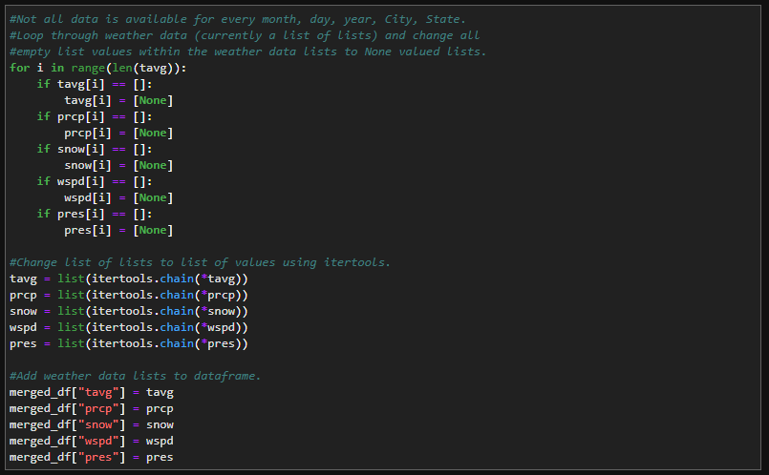
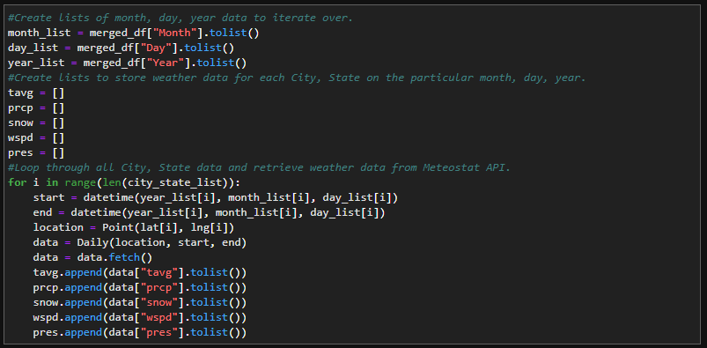
Report Results
Does weather affect total score?
Google Maps API used on “City, State” column to obtain latitude and longitude data. Meteostat API used on latitude, longitude, month, day, and year values to obtain weather data.

Slide 9
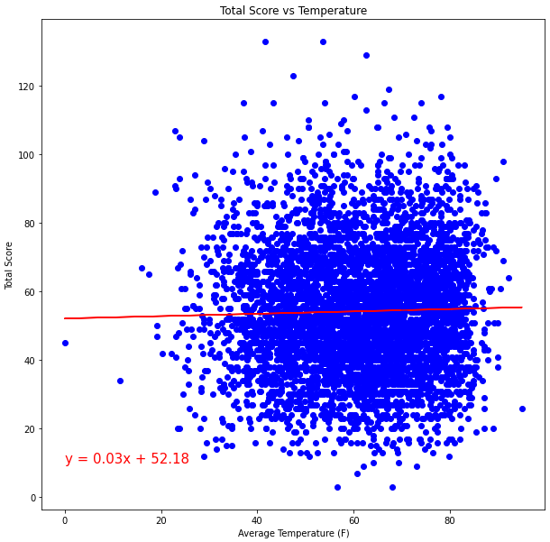
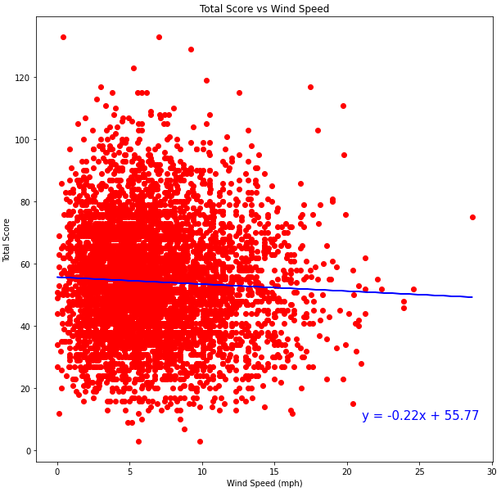
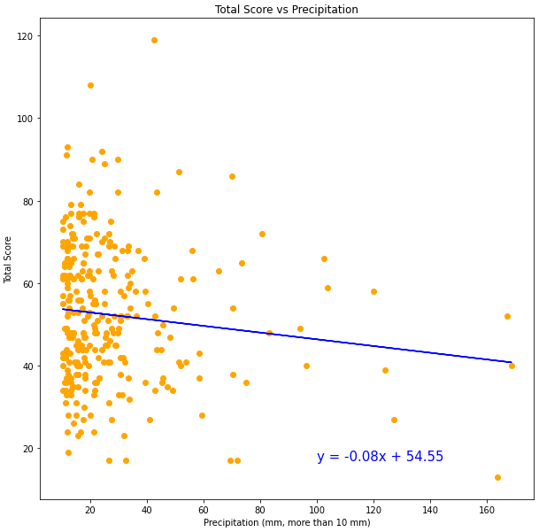
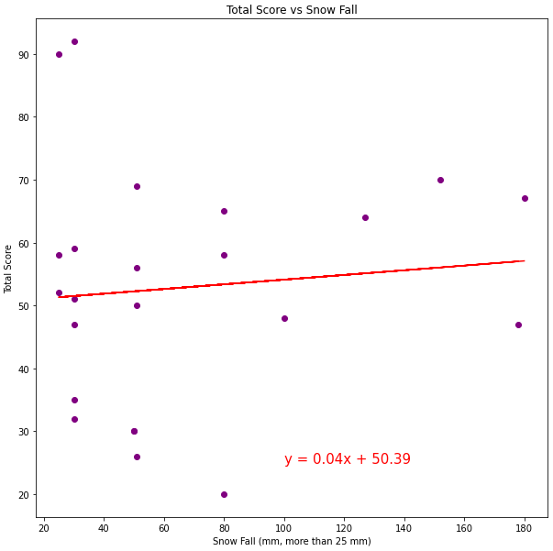
Report Results
Does weather affect total score?
Compared total score to four different weather conditions (temperature, wind speed, precipitation, and snowfall). No correlation between any of these weather conditions and total score of the game.

Slide 10
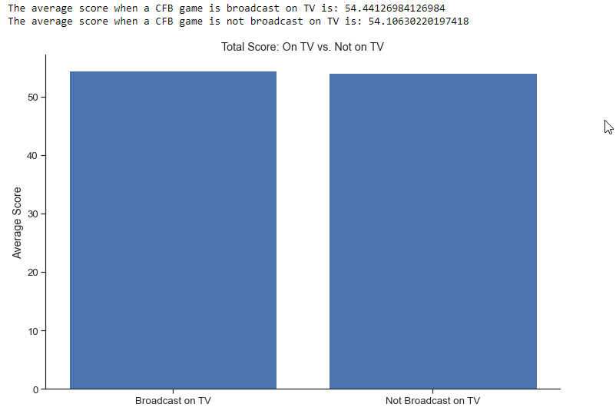
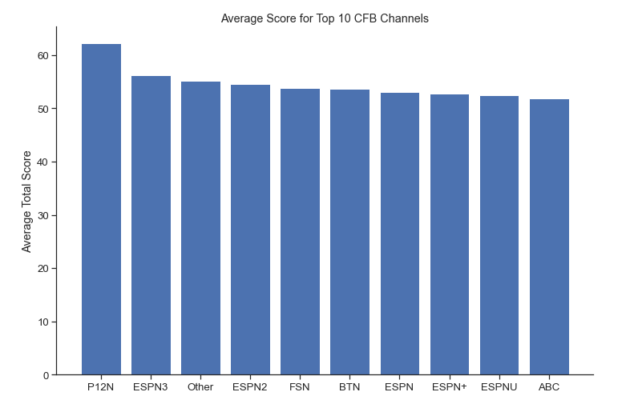
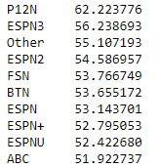
Report Results
Do televised games affect total score?

Slide 11
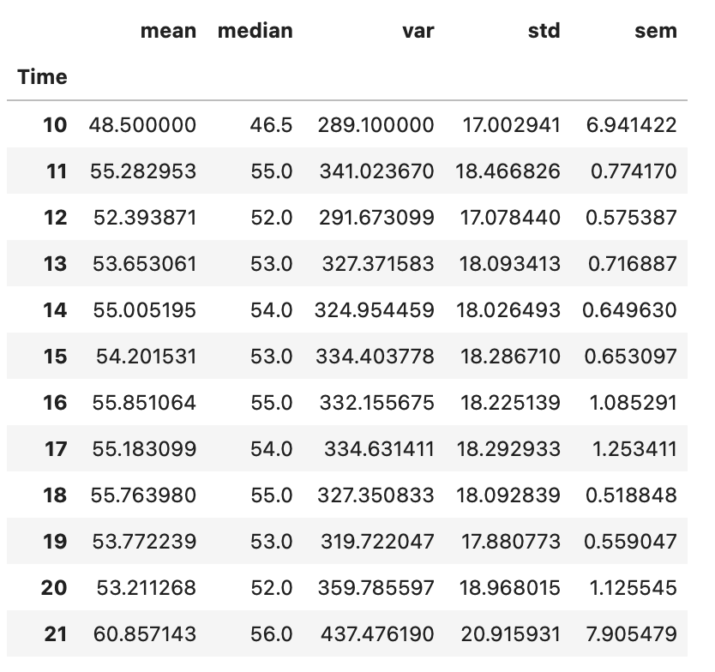
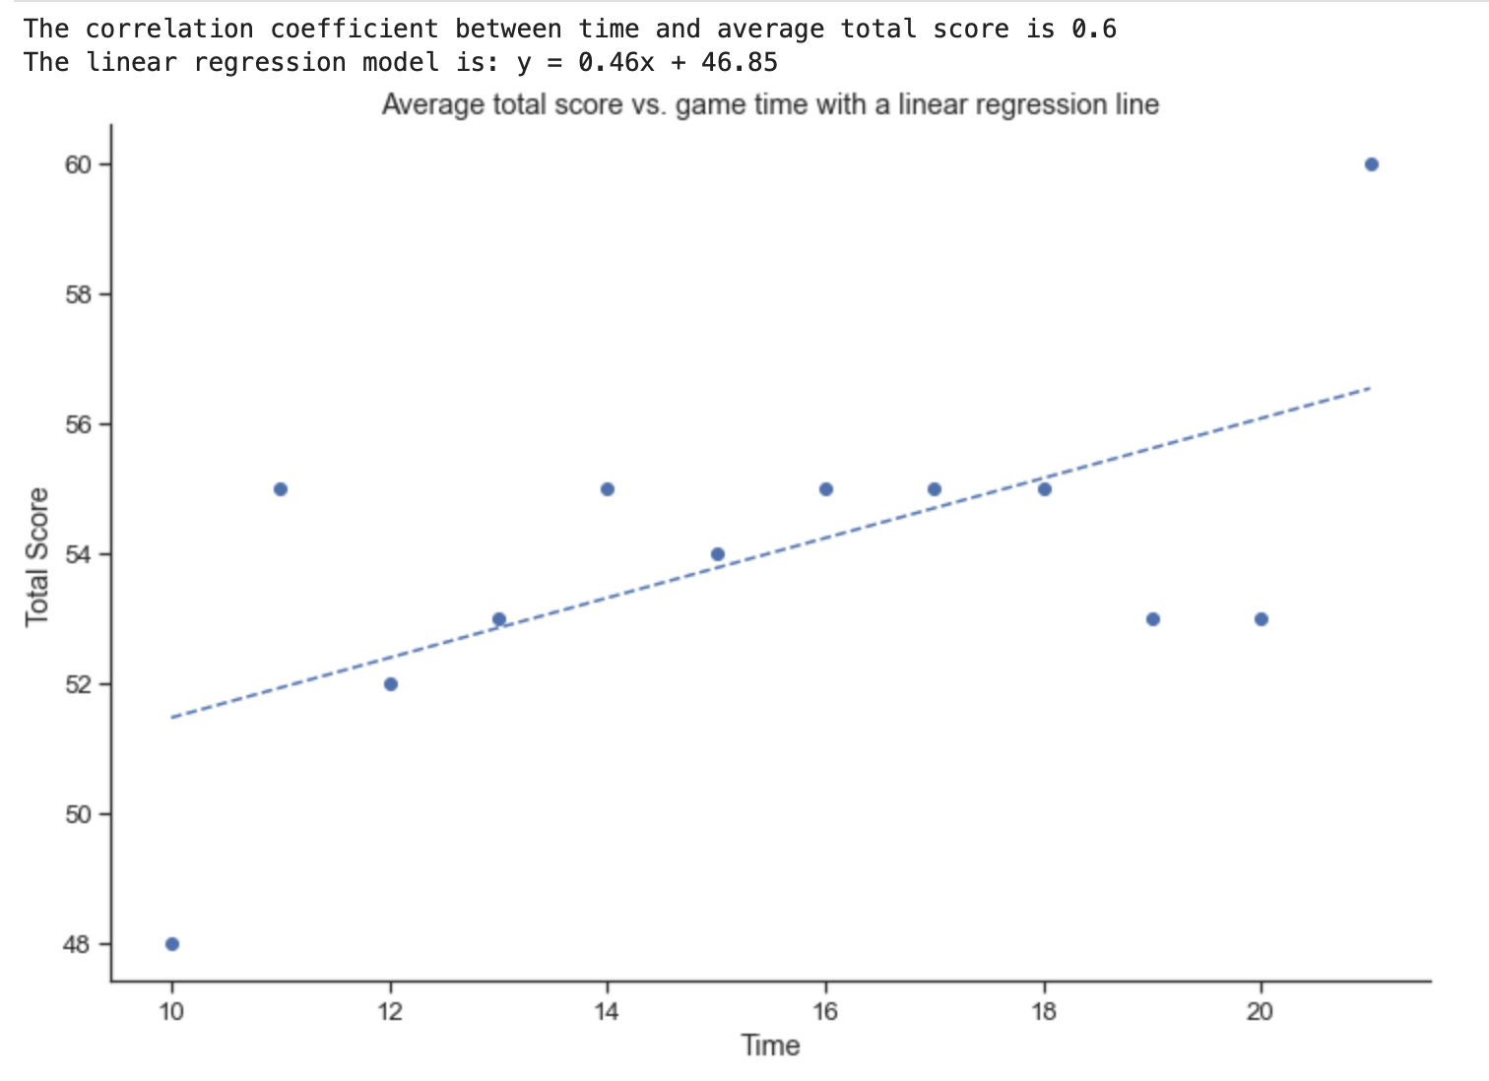
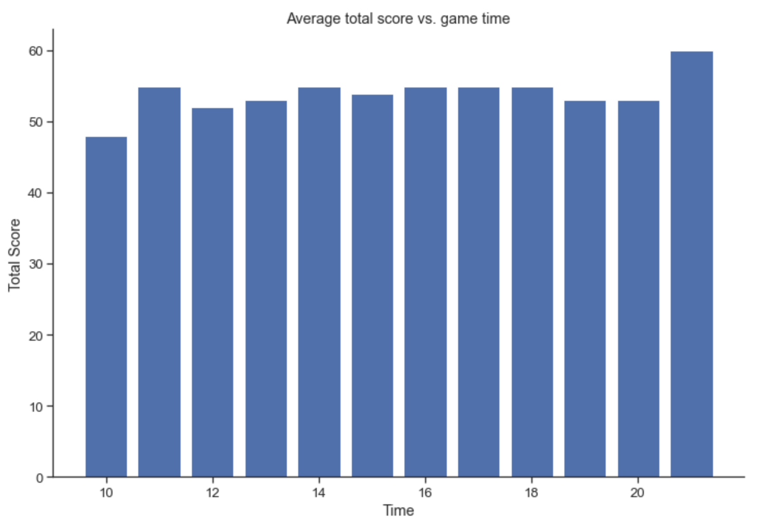
Report Results
Does the start time of the game affect total score?
As the time of the game gets later the total score tends to increase. The later game time and total score demonstrates a positive correlation.

Slide 12

Conclusion
We set out to discover what if any outside factors could affect the total score or winner of a college football game for the purpose of improving betting odds. Using a dataset of around 7000 games, we analyzed how attendance, weather, time, and television affected total score and/or the winner. While we did find some correlations, none stood out to us as strong, clear indicators for use in improving one's sports betting. Therefore, we recommend listening to expert sports betters or using data specific to the two teams playing before losing your money.

